Slide 1
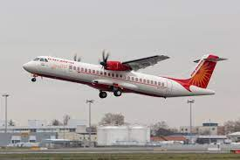
FLIGHT SAFETY NEWS LETTER
In Focus: Conducted ERP Table Top Exercise on 27th December 2023
Meetings/Engagements
Upcoming Events: SRBM(Safety Review Board Meeting) & ERP Mock Drill on 28th Feb 2024
Case Study: Occurrence of Flight JL516 on 02nd Jan 2024(Japan Airlines)
Kindly Contact for ERP on 01125672289, 08800744303, 09871149284.
ERP Email Address: emergency.response@allianceair.in
Kindly Contact Flight Safety on 01125671574
Flight Safety Email Address: aasl.flightsafety@allianceair.in

Slide 2
In Focus
ERP Table Top Exercise
27th December 2023
Conducted ERP Table Top Exercise for smooth operation of Emergency Response Procedure :-
Accident/Incident: 9IAAA during takeoff rolled from Silchar-Kolkata, Eng 1 went on fire due runway incursion during takeoff and it was rejected with minor injuries (04).Nil causalities.
Date: 27Th Dec 23
Location: ECC/Online
Affected Airline/Airport: Alliance Air Aviation Ltd. /Silchar
Participants: Alliance Air Aviation Ltd.
Aircraft Call Sign/Registration/Type: 9IAAA/VT-AIV/ATR-72
Sector: Silchar/Kolkata

Slide 3
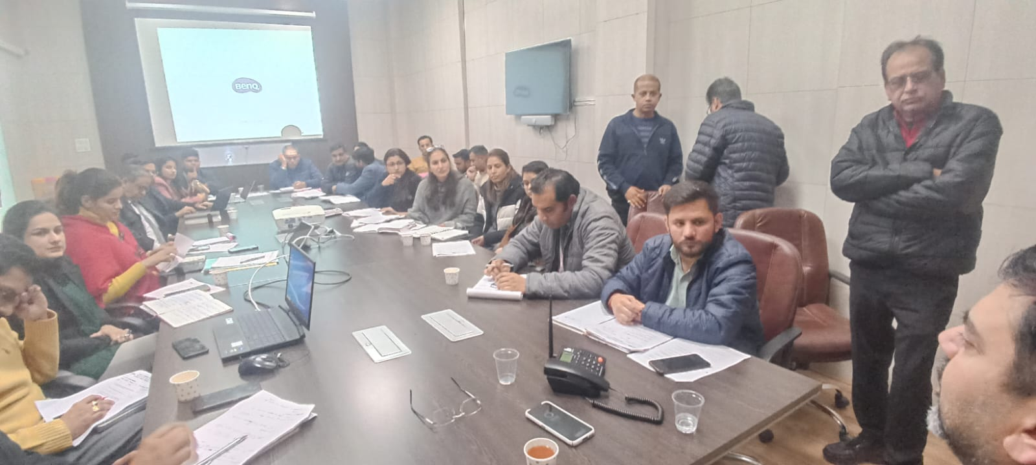
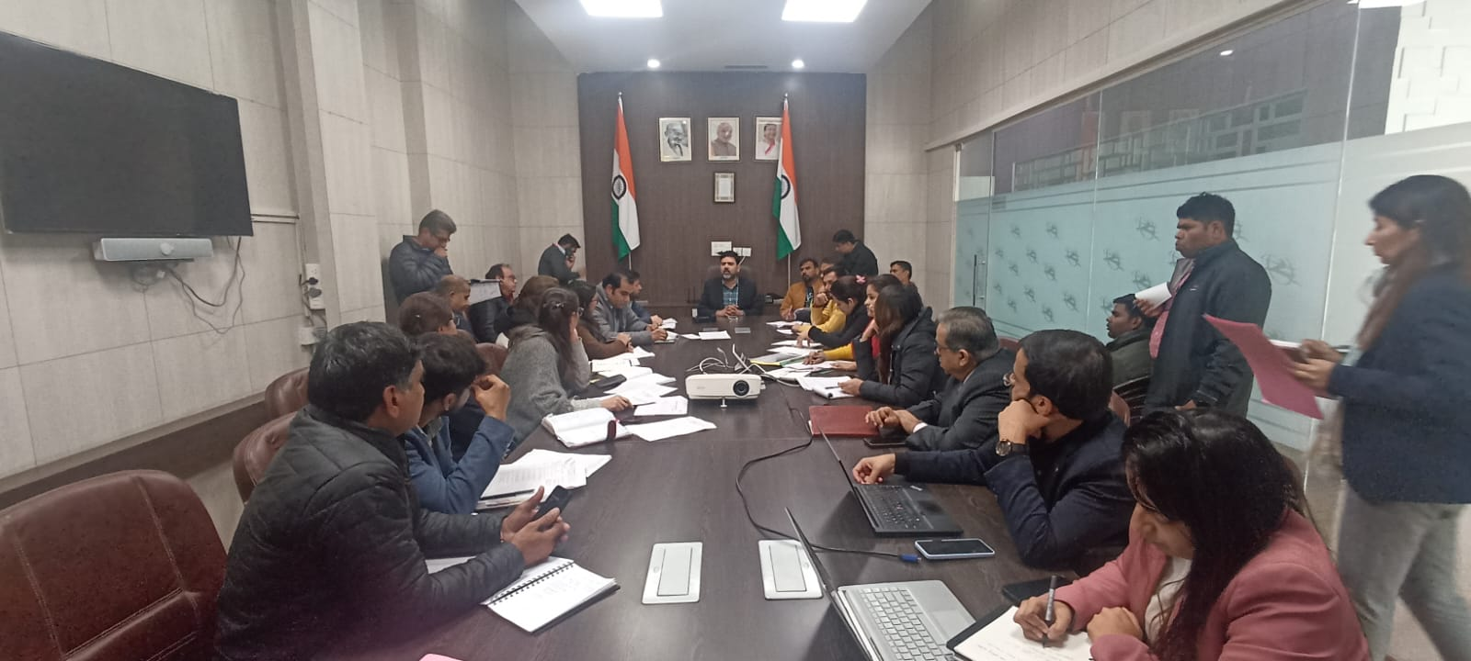
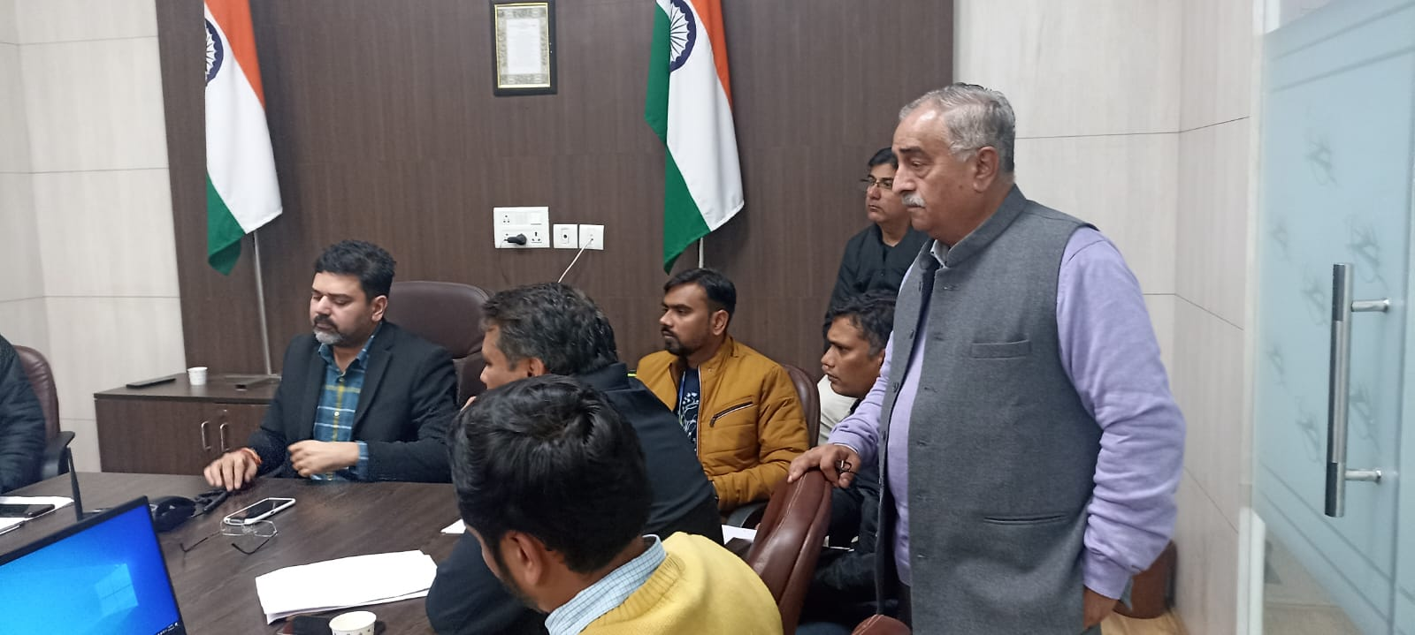
Meetings/Engagements
ERP Table Top Exercise
27th December 2023

Slide 4
Upcoming Events:
SRBM (Safety Review Board Meeting) & ERP Mock Drill Scheduled on 28st February 2024.

Slide 5
Case Study: Occurrence of Flight JL516 (Japan Airlines)
Date: Tuesday 2 January 2024
Time: 08:47 UTC
Type: Silhouette image of generic A359 model; specific model in this crash may look slightly different
Airbus A350-941
Owner/operator: Japan Airlines
Registration: JA13XJ
MSN: 538
Year of manufacture: 2021
Engine model: Rolls-Royce Trent XWB-84
Fatalities: Fatalities: 0 / Occupants: 379
Other fatalities: 5
Aircraft damage: Destroyed
Category: Accident
Location: Tokyo-Haneda Airport (HND/RJTT) - Japan
Phase: Landing
Nature: Passenger - Scheduled
Departure airport: Sapporo-New Chitose Airport (CTS/RJCC)
Destination airport: Tokyo-Haneda Airport (HND/RJTT)
Investigating agency: JTSB

Slide 6
Narrative:
Japan Airlines flight JL516, an Airbus A350-941 (JA13XJ), collided with a Japan Coast Guard DHC-8-315Q MPA aircraft (JA722A) on the runway at Tokyo-Haneda Airport. The DHC-8, which was on its way to transport supplies to Niigata in response to the Noto Peninsula earthquake which happened the day before, had taxied onto runway 34R via taxiway C5 as JL516 was on final approach. After touching down, the A350 struck the DHC-8. The nose section of the A350 suffered severe damage. The Airbus slid over the runway for about 1700 meters, until it veered to the right, coming to stop next to the runway just before the intersection with C11, and a fire erupted in both aircraft. All occupants of the A350 evacuated safely via L1, R1 and L4 doors. One passenger suffered injury of crack(s) in rib(s), another one a bruise, the third people a sprain. 12 others also sent to hospital due to feeling unwell. The captain of the DHC-8 Japan Coast Guard aircraft also survived with severe burn injuries. The remaining crew of five were killed in the accident.
Communications released by Ministry of Land, Infrastructure, Transport and Tourism indicate that JL516 had been cleared to land on runway 34R. JA722A had been instructed to hold short on taxiway C5. This instruction was read back correctly, however, the survived captain of DHC-8 asserted just after the accident that he had been cleared for takeoff, which is contrary to the ATC record. Additionally, it appears the stop bar lights for taxiway C5 (and other taxiways) was unserviceable, as per Notam published on December 25: "STOP-BAR-LGT FOR C1 THRU C14-U/S".

Slide 7
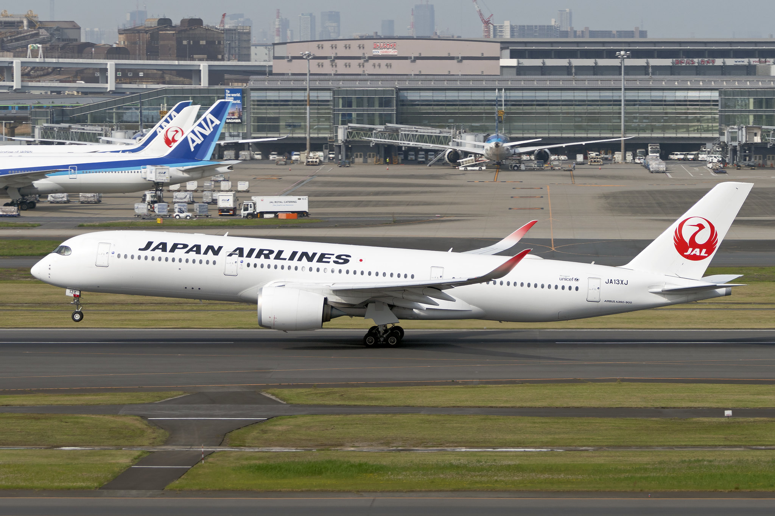

Slide 8
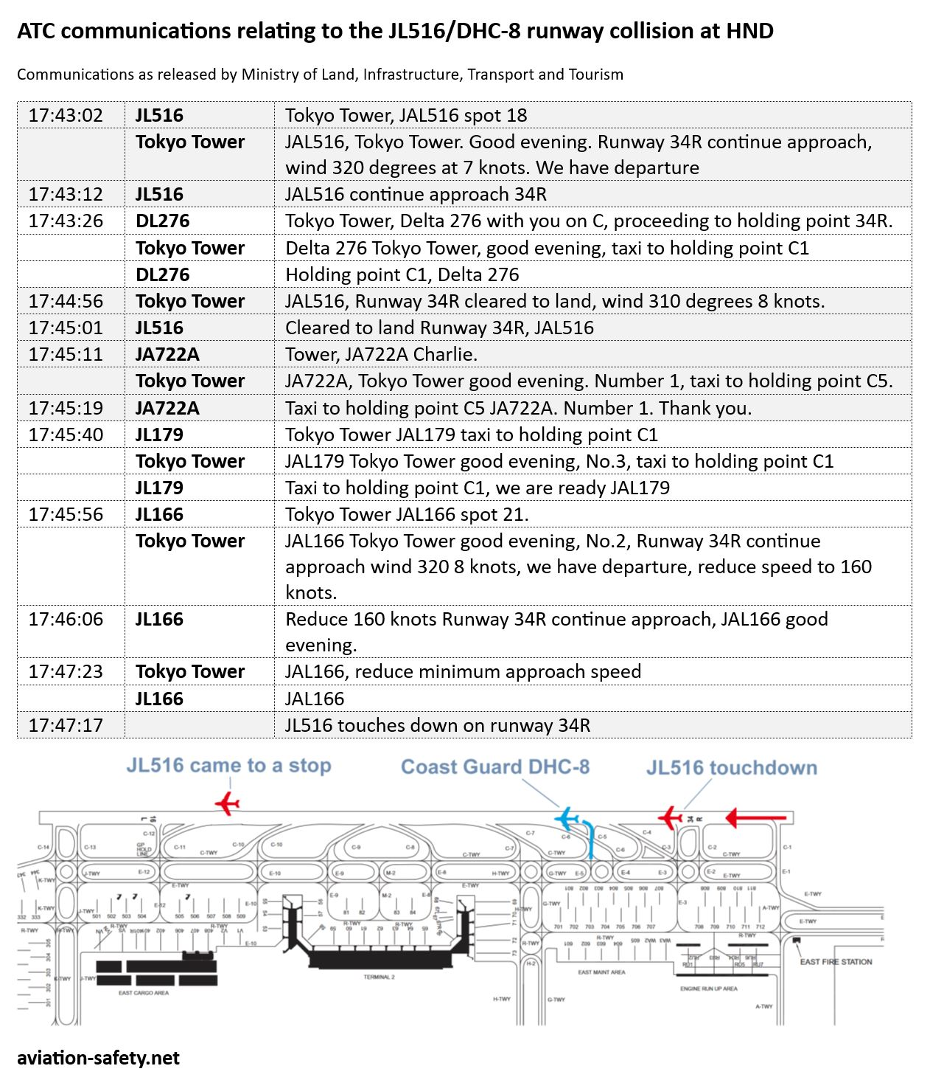

Slide 9
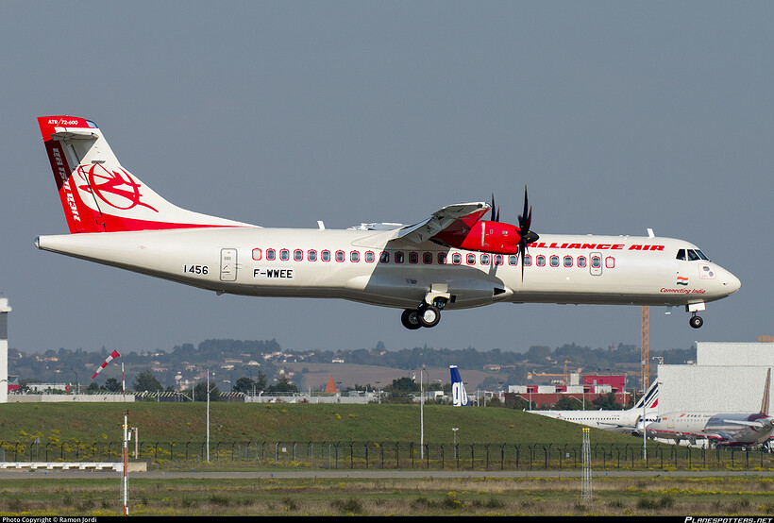
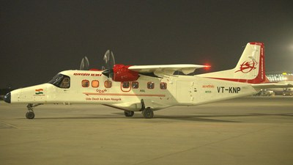
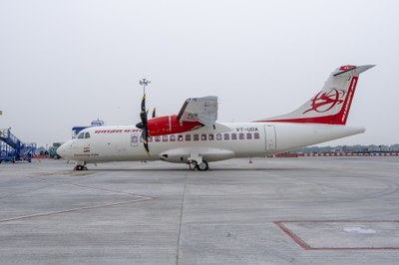
Our Fleet
सादर/Regards, विकास शर्मा/Vikas Sharma उड़ान संरक्षा प्रमुख/Chief of Flight Safety, Head-ERP एलाइंस एअर/Alliance Air

